Slide 1
DIP 2013 – Smart Fast Forward

Slide 2
Overview

Slide 3
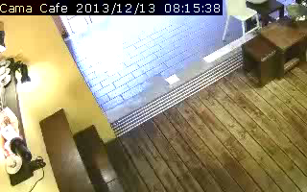
Smart Fast Forward Concept

Slide 4
Processing Stage Overview
Multi-Threaded!
OpenCV
Decoder
Background
Subtraction
Object Detection
Video
Object Regions & Labels
Object Labeling
(Tracking)
Frame weight
estimation
Kalman
Filter
Playback Speed

Slide 5
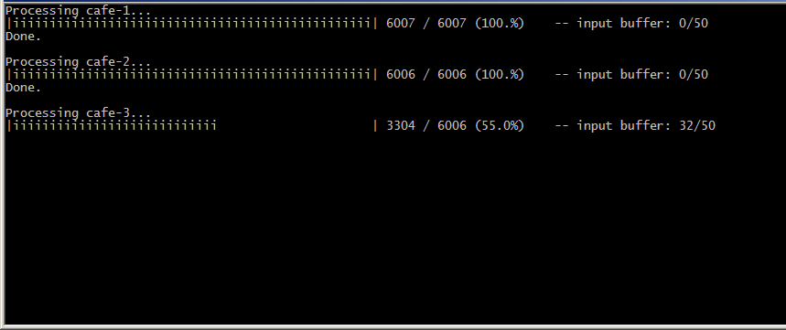
Processing Stage Output

Slide 6
Background Subtraction

Slide 7
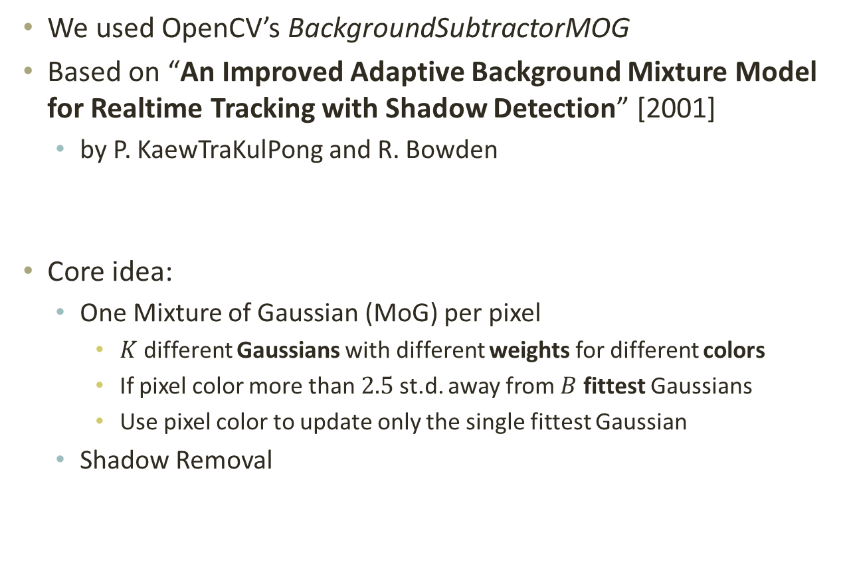
Background Subtraction MoG
We used OpenCV’s BackgroundSubtractorMOG
Based on “An Improved Adaptive Background Mixture Model for Realtime Tracking with Shadow Detection” [2001]
by P. KaewTraKulPong and R. Bowden
Core idea:
One Mixture of Gaussian (MoG) per pixel
$K$ different Gaussians with different weights for different colors
If pixel color more than $2.5$ st.d. away from $B$ fittest Gaussians
Use pixel color to update only the single fittest Gaussian
Shadow Removal

Slide 8
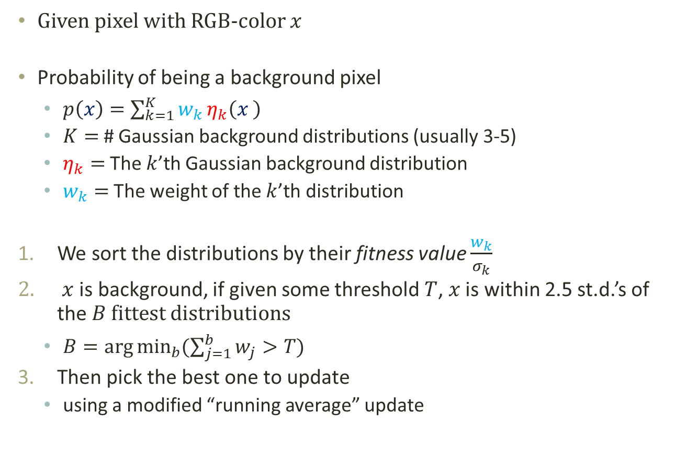
Background Subtraction MoG
Given pixel with RGB-color $x$
Probability of being a background pixel
$p\left(x\right)=\sum_{k=1}^{K}{w_{k}}η_{k}\left(x \right)$
$K=$ # Gaussian background distributions (usually 3-5)
$η_{k}=$ The $k$’th Gaussian background distribution
$w_{k}=$ The weight of the $k$’th distribution
We sort the distributions by their fitness value $\frac{w_{k}}{σ_{k}}$
$x$ is background, if given some threshold $T$, $x$ is within 2.5 st.d.’s of the $B$ fittest distributions
$B=\arg{\min_{b}{(\sum_{j=1}^{b}{w_{j}}>T)}}$
Then pick the best one to update
using a modified “running average” update

Slide 9
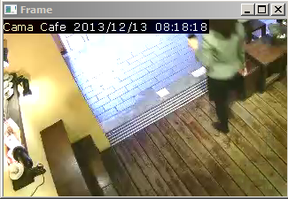
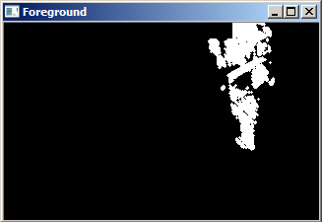
Background Subtraction Results

Slide 10
Object detection TODO: ???

Slide 11
Clustering

Slide 12
Playback Speed estimation

Slide 13
Playback Speed Estimation Frame Weights
TODO

Slide 14
Playback Speed Estimation Noise-Aware Smoothing

Slide 15
Results
TODO

